Slide 1


Orchestrator Architecture Overview with System Center 2012 SP1 Orchestrator Andreas Rynes Datacenter Architect Microsoft Corporation
Microsoft Virtual Academy
Notes:
Welcome to the Microsoft Virtual Academy, thanks for joining us today, this session we will cover the Orchestrator Architecture with System Center 2012 SP1 Orchestrator. My name is Andreas Rynes, I’m a Datacenter Architect in the worldwide datacenter, private cloud center of excellence, and I’m covering today the architecture of our Orchestrator 2012 version and what are actually the objectives for today.

Slide 2
Objectives
Describe the components in the Orchestrator (SCO) architecture
Understand the functionality of the components within a SCO infrastructure
Notes:
First of all I would like to describe all the components of Orchestrator architecture and then we are going a little bit more into the details about the functionality of those components within an Orchestrator infrastructure.
Objectives
Start Time 00:01 / Length: 1 minute
Microsoft Lync tools used on this page:
None
Review the learning objectives.

Slide 3
Agenda
Introduction to SCO
How are Customers using SCO
SCO and System Center Integration
SCO Terminology
SCO Architecture
SCO Tools
Component Connectivity
Component Security
Redundancy
Notes:
So here is the agenda for this session first of all I would like to introduce you to Orchestrator, then I will cover a couple of customer scenarios, how customers are using Orchestrator in production environments, then we are going to cover Orchestrator and the System Center Integration so how does Orchestrator works together with all the other System center components then we will handle a little bit of the terms about Orchestrator, the terminology and then we will go right into the architecture and we will also cover the tools that are available with Orchestrator and how you are going to use them and then we will also talk a little bit about connectivity stuff so which ports are going to use in Orchestrator environment, a little bit about the security as well and about redundancy so that’s the overall agenda for this session for the next 20 minutes.
IPv6 Subnet and Address Planning
Start Time 00:04 / Length: 3 minutes
Microsoft Lync tools used on this page:
None
Take the students through the subnet and address plan. Explain the various stages of how the plan comes together.

Slide 4
Introduction to Orchestrator
SCO provides an environment for Process Automation, also known as Run Book Automation (RBA), which is the ability to orchestrate and integrate IT management tools through runbooks.
Automation can reduce costs, simplify management and optimize resources through:
Multi-vendor integration, no rip & replace or vendor lock-in
Pre-built activities & workflow processes to speed time to value
Replaces manual, resource-intensive, and error-prone activities
Configuration of workflows is done without coding or scripting
Intelligent workflows with rule-based branching
Automation that spans multiple IT components, disciplines and silos
Notes:
So first of all I would like to give you a very short introduction to Orchestrator, what it is, actually Orchestrator gives you provides you an environment for Process Automation so this is also known as the Run Book Automation and the overall goal is to give you the ability to orchestrate and integrate IT Management tools through those run books. So automation can reduce costs and also simplify the management and optimize resources with System Center Orchestrator you will get multi-vendor integration so you’re not locked in, in a specific vendor, you can really work across your systems, your platforms and your tools you’re going to use today. There are a couple of pre-built activities and workflow processes already there so that will speed up the time to make that happen. And it will also replace manual tasks and activities you have to do all day long in your data centers today and with out any coding or scripting you’re able to really build workflows and configure those workflows and run them, so you don’t have to code anything depending on your requirements of course. And what I said before, it really spans about multiple IT components, disciplines and silos so bring all those stuff together that you are having in your data centers today.

Slide 5
Capabilities
Capabilities
Orchestrator provides a workflow management solution for the data center to automate processes regardless of
Hardware
Platform
Tie disparate tasks and procedures together
Using the graphical user-interface (Runbook Designer)
Create reliable, flexible, and efficient end-to-end solutions
Notes:
So what are actually the capabilities of Orchestrator, so it’s a workflow management solution for your data center to really automate your processes and regardless of your hardware and your platform the tools you’re going to use. And it really brings together those disparate tasks with one graphical user interface which is called the Runbook designer but we will cover that in a moment, and you have really one front end designer where you build your workflows across all your systems and tools. And it really enables you to really have those end to end solutions that are flexible and efficient and really easy to design and build.

Slide 6
Cross Platform
Capabilities
Integration with System Center
Integration with other Microsoft products
Integration with non-Microsoft products
Enable interoperability
Improved efficiency
By eliminating or crossing technology and organizational process structures
Extending capabilities with integration packs
Include additional functionality
For Microsoft and non-Microsoft products and technologies
Notes:
So when I talked about cross platform what does that mean, so first of all of course we have a very deep integration with all the other system center components like Operations Manager, Service Manager, and the others and you also have integration with other Microsoft products like Active Directory and SQL Server as well as integration with non-Microsoft products so there is a bunch of integration packs available that gives you the ability to not only talk to Microsoft products but also to talk to non-Microsoft products and to involve those products in your workflows in the datacenter. So it enables interoperability and it really improves the efficiency of your daily job in the datacenter so you can eliminating those structures between different organizations as well as technology. And with the integration packs that I’ve mentioned before you’re really extending the capabilities of Orchestrator so Orchestrator comes with a set of basic functionality and activities that are out of the box and with those integration packs no matter if they are for Microsoft products or non-Microsoft products you’re able to extend that capabilities and import additional functionality to System Center Orchestrator.

Slide 7
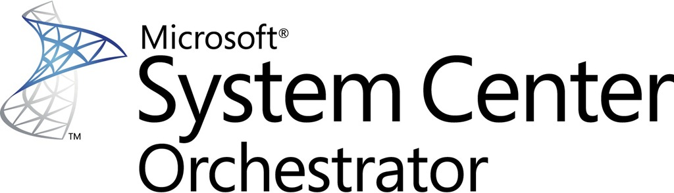


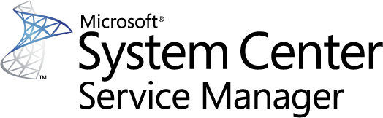
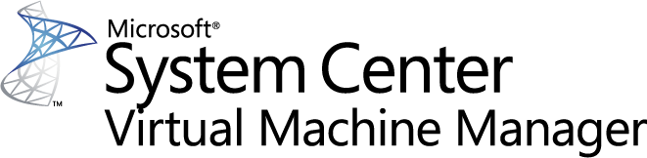
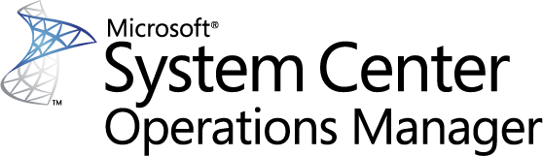
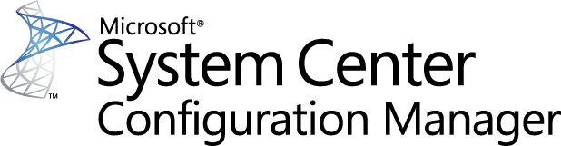
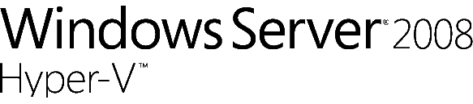

How customers are using SCO
Capabilities
Incident Management
Virtual Machine Life-Cycle Management
Service Manager : CMDB Automation
Orchestrate incident management and resolution
Integrate across monitoring tools, service desks, and configuration management databases (CMDBs)
Automate provisioning, resource allocation and retirement
Extend virtual machine management to the cloud
Automate CI updates in the CMDB
Create new objects and relationships between objects
Notes:
So as mentioned before I would also like to a couple little bit about how customers are using Orchestrator today and three examples you’re going to see here are really three out of many, first of all incident management so Orchestrator really helps you to bring your incident management and resolution together, it helps you to automate tasks that you want to involve in your incident management and it really integrates across all that disciplines that are used with that incident management so for example service tasks with your CMDB, with monitoring tools and stuff like that so those are the main two products that Orchestrator brings together Service Manager and Operations Manager.
The second one is Virtual Machine Life Cycle Management when you think of how to provision virtual machines, how you do your allocations, and how you do your deep provisioning you’re really able to use Orchestrator to help you in automating those processes, from the very beginning of a virtual machine up to the end where it will be de provisioned again.
And last but not least Service Manager, CMDB Automation so think about your configuration items to the updates you want to try within your CMDB about new relationships between those objects within the CMDB and Orchestrator can really help you to drive that and to really automate those tasks and really work across Service Manager, Configuration Manager as well as maybe an already existing ticketing system in your data center.

Slide 8
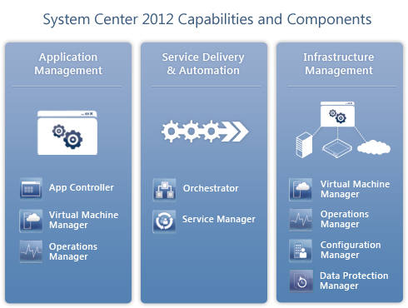
System Center 2012
Capabilities
Notes:
So if we talk about Orchestrator which is actually one component of the System Center 2012 suite we have to talk a little bit about the capabilities and components so those three pillars that you see here are the main pillars and the main capabilities of System Center 2012. First of all it’s application management, application management really empowers you to really deliver predictable applications as services to your business or counterparts. And it really offers the application owners to have a single view and to manage their application services across traditional datacenter, across private and public clouds and of course it also extends their how to monitor those applications no matter where they live if they live in a public cloud like on Windows Azure or if they live within your datacenter. That’s actually Application Monitor, one of the three pillars within System Center 2012.
The second one is Service Delivery and Automation. With System Center 2012 you are really able to automate core organizational process workflows for example incident manager which we covered the slide before, problem management, change management and also release management can also integrate and extend tool sets and build flexible workflows to automate processes across your IT assets in your organization and one way to do that is using System Center 2012 with Orchestrator and of course Service Manager as the foundation for your CMDB.
Last but not least is Infrastructure Management and within Infrastructure Management it’s kind of interesting System Center 2012 provides you really one common management toolset and you’re able to monitor and operate IT Infrastructure and it doesn’t really matter if your physical hardware, your virtual resources or virtual machines if it’s public or private cloud you have one single set of tools to manage all those different type of resources.

Slide 9
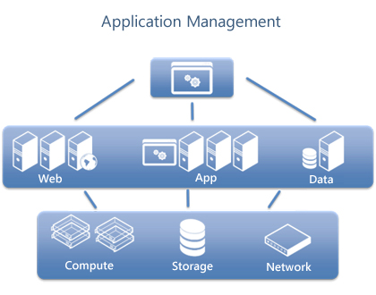
System Center – Application Management
Capabilities
Notes:
Standardized Application Provisioning
Utilize service templates to define standardized application blueprints for your private cloud. A service template would typically include specifications for the hardware, operating system, and application packages that compose the service.
Support for multiple package types for Microsoft .NET applications, including MS Deploy for web tier (IIS), Microsoft Server Application Virtualization (Server App-V) for application tier, and SQL Server DAC for data tier.
Specify application configuration requirements like topology, elasticity and scale-out rules, health thresholds, and upgrade rules.
Provides a self-service experience to trigger “one click” application deployment.
Comprehensive Application Manageability
Server App-V, a unique technology in System Center 2012, offers the following capabilities:
Optimizes your applications for private-cloud deployments by abstracting the application from the underlying OS and virtual infrastructure.
Enable image-based management, which helps simplify application upgrades and reduce your application maintenance costs.
Deep Application Diagnostics and Insight
Offers deep application and transaction monitoring insight for .NET applications (and J2EE application server health).
Helps you efficiently isolate the root cause of application performance issues down to the offending line of code.
Integrates with Microsoft Visual Studio to unlock dev-ops collaboration, thereby helping you remediate application issues faster.
Offers easy-to-use reporting and custom dash-boarding.
Common Application Management for Hybrid Models
Offers your application owners with a single view to manage their application services across traditional, private and public clouds.
Extend your on-premises monitoring experience to the public cloud with the System Center Monitoring Pack for Windows Azure applications.
TRANSCRIPT STARTS HERE
To go into a little bit more detail what Application Management with that figure that you see on your screen right now, this represents a three tier service with front end, with a middle tier and a back end and that’s associated with virtual infrastructure which hosts those components and System Center 2012 offers really a service centric approach to help you manage your application components really in a context of a holistic business service so it utilizes service templates to do standardized application footprints for your private clouds so you’re defining a service template that consists of a couple of different tiers like the one you see on your screen right now and it typically includes application for the hardware, for the operating system and application packages and then you’re going to compose that service and there are actually multiple packages available within the service template so for Microsoft.net applications including MS deploy for web app tier, service application for virtualization, server app V, for application tier, and SQL Server back for data tier. And this really, this service template specify application configuration requirements like topology, elasticity, scale out rules, help thresholds, upgrade rules and stuff like that, and you’re then by providing that service template, your consumer your application owners will create an instance of that application with a couple of clicks, with their portal that’s all about application management.

Slide 10
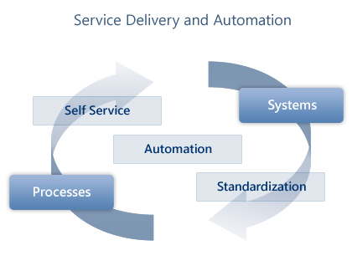
System Center – Service Delivery
Capabilities
Notes:
Standardize Services Provided to IT Service Consumers
Define service offerings available for request by leveraging dependencies in central management data base (CMDB) to publish standardized service offerings.
Ensure compliance with pertinent industry regulations and business needs.
Identify approval processes and workflows to fulfill service requests.
Empower Consumers of IT Services with the Ability to Identify, Access and Request Services
Provide easy navigation with intuitive interface.
Deliver services based upon service consumer roles.
Ensure capture and tracking of required service request information.
Automate Service Processes and Systems Necessary to Fulfill IT Service Consumer Requests
Automate routing of requests for approval and notification.
Automate provisioning of service requests for end-to-end request fulfillment.
Integrate automation across System Center and third-party management components.

Slide 11
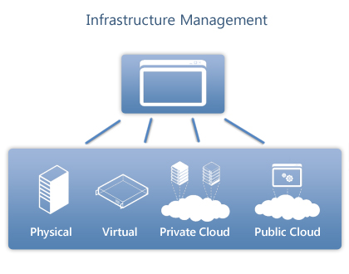
System Center – Infrastructure Management
Capabilities
Notes:
Provision your Physical and Virtual Infrastructure
Support deployment and configuration of virtual servers and Hyper-V with Virtual Machine Manager.
Manage VMware vSphere and Citrix XenServer using one interface.
Automatically deploy Hyper-V to bare metal servers and create Hyper-V clusters.
Provision everything from operating systems to physical servers, patches, and endpoint protection with Configuration Manager.
Provision Private Clouds
Use "create cloud" functionality in Virtual Machine Manager to aggregate virtual resources running on Hyper-V, vSphere, and XenServer into a unified private cloud fabric.
Customize and assign private cloud resources to suit your organization’s needs.
Deliver self-service capability for application owners to request and automate provisioning of new private cloud resources.
Operate Your Infrastructure
Leverage a single console and customizable dashboards in Operations Manager to monitor and manage your physical, virtual, networking, application, and cloud resources.
Dynamically optimize virtual resources for load balancing and power efficiency.
Protect your physical and virtual resources with Endpoint Protection and Data Protection Manager.
Automatically patch your physical and virtual resources with Configuration Manager and Virtual Machine Manager.
Automatically track and create custom
TRANSCRIPT STARTS HERE
So last but not least let’s go into the infrastructure management and here we have System Center 2012 providing you really a common management toolset to help you to configure, provision, monitor and operate your IT infrastructure, and if your infrastructure is like that of most organizations you have physical and virtual resources, running really different operating system and you want to manage them all and with system center 2012 you’re able to deploy and configure virtual service like hyper V with Virtual machine manager but you’re also able to manage third party hyper visors like VM Ware and SAM Server one interface and you’re also able to deploy Hyper V to bare metal servers and create hyper v clusters and also really do patching for your infrastructure. So this is more or less the deployment stuff of your infrastructure but you also want to operate your infrastructure and you have really again one single console and customizable dashboards in Operation Manager to really monitor and manage your physical virtual network application and cloud resources all in one common set of tools like that you have in System Center 2012. You have the opportunity to optimize your virtual resources for load balancing on power to get more power efficiency, you’re able to use end point protection and data protection manager to protect your physical and virtual resources and you are also able to automatically patch your physical and virtual resources using Configuration Manager and Virtual Machine Manager automatically. And you’re also able to track and create custom reports for hardware inventory software inventory and software usage metering, so that’s all part of the infrastructure management pillar of System Center 2012.

Slide 12

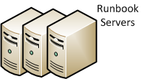
Orchestrator Terminology
Management server
Communication layer between the Runbook Designer and the orchestration database
Runbook server
Runs all instances of runbooks
Runbook servers communicate directly with the orchestration database
Multiple runbook servers per Orchestrator installation increase capacity and redundancy
Notes:
So with that overview about System Center 2012 let’s go into more detail of Orchestrator, one component of system Center 2012 and to get into more of the details of Orchestrator I would like to cover a couple of terms that you will hear all the time, not only in this session but also in the upcoming session one of that is the management server. Actually the Management Server of Orchestrator is the communication layer between the Runbook designer, the tool you’re going to use to design your runbook, you’re designing the workflows there, and the orchestration database. Actually the orchestration database is one SQL server database where all the runbooks are hosted and stored. So the Management server really enables you to communicate between the designer and the database.
The runbook server and you see on the right there might be a couple of runbook servers, not only one instance of that the runbook server is responsible to run all instances of your runbooks and the runbook servers communicate directly with the orchestration database and what I said already, multiple runbooks per orchestrator installation are possible to increase capacity and redundancy.

Slide 13

Orchestrator Terminology
Activity
Single task in a runbook that performs a specific function
Data bus
A mechanism in Orchestrator that passes information from one activity in a runbook to another activity
Published Data
Data that is published to the databus from each activity in a runbook
Notes:
Couple of more terms, activity, actually activity is a single task in a runbook that performs a specific function, one example you see on the screen is create user, that’s a single activity that will create the user in Active Directory and we will cover that in a little bit more detail in a second.
The Data bus also a very rich mechanism in Orchestrator that allows you to pass this information from one activity in a runbook to another activity so you’re able to consume the output of one activity in the next activity by using the data bus in Orchestrator.
And to do that each activity has to publish data to the data bus and that will happen automatically in for the activities in the integration pack that are available in that part of Orchestrator itself, but you’re also able to publish you're own data to the data bus by using Published Data.

Slide 14
Orchestrator Terminology
Database
Contains all deployed runbooks
Status of running runbooks
Log files and configuration data
Runbook
A sequence of activities that orchestrate actions on computers and networks
Runbook Designer
Tool used to build, edit, and manage Orchestrator runbooks
Notes:
So couple of more terms here database, actually that database contains all deployed runbooks and also the status of those runbooks so you’re able to see which runbooks are running and what is the status of those runbooks and of course it keeps all the configuration of data and log files of Orchestrator in that database.
The runbook itself, actually that’s the workflow, it’s a sequence of activities that orchestrate actions on computers and networks across tools, across systems, across organizations and that’s a runbook, that really holds the complete workflow.
And the runbook designer that’s the tool you’re going to use to build and to manage your Orchestrator runbooks and we will see that in the next session where we are going into more into the details of the interfaces that are available with Orchestrator.

Slide 15
Architecture
Notes:
So from an architecture perspective you see a couple of those terms that I’ve described already, you see the management server that will communicate between the runbook designer and the database itself, the runbook servers on the very top of that picture are going to communicate with the database itself and then one part I didn’t mention in the terms section was the Orchestrator web service we have a REST based web service that is configured by default on port 81 and that rest based web service can be used by third party solutions as well as the Orchestration console. So the Orchestration console is actually a web application that’s by default on port 82 and you’re able to use that in a browser to control your runbooks and also get real time information about the runbooks and the status of that runbooks.

Slide 16
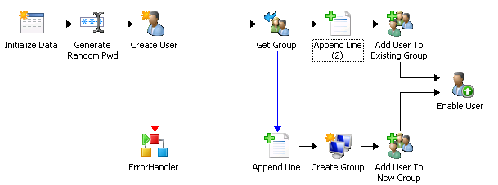
Runbook Sample
Notes:
So one sample of a runbook how it can look like and that’s a very simple example but I think you get the idea of that, so you have a graphical user interface that’s going to be provided by the runbook designer and you’re able to grab the activities from the toolbox, put it on the surface and using the links to bring that activities together and what you see here on the left is initialize data activity where you define the parameters that will be used by that runbook and then you have a couple of activities for example that generate random password that do what it says, actually it’s generates a random password and then it uses the activity that we saw already the create user activity that probably you cannot see it here but it will probably take parameters that are part of the initialized data and also use the output of the generate random password activity to create a user in the Active Directory. Below that you will see the error handler activity that’s actually an activity that calls another runbook which actually does some error handling techniques.
And on the right it will go to grab a group and depending on if the users already in that group it will add the user to an existing group or if that group doesn’t exist it will create that group and then add that user to the group and at the very end it will enable that user in Active Directory, so that’s a pretty simple example for runbook, how it can look like, and I think that will give you an idea how that works.

Slide 17
Stages of a Runbook
Administrator creates runbook (Designer)
Commit/Check-in to the database (Designer)
Start runbook (Designer/Console)
This will create a job in the database
Runbook server is monitoring for new jobs
Runbook server copies runbook locally
Processing the runbook
Status information, activity results and data is recorded in the database
Notes:
So what are the stages of a runbook, first of all an administrator creates a runbook in the Designer so you’re going to use the runbook designer to really create that runbook, then he has to check in that to the database and then he’s able to start that runbook he can do that actually in the designer, within the designer or you’re able to do that within the console the Orchestrator console. This actually, as soon as someone clicks start runbook button, will create a job in the database and a runbook server is actually monitoring for new jobs that occur in the database and as soon as that happens and the runbook sees that new job it will actually grab the runbook, copies that runbook locally to the runbook server and then starting processing the runbook. And of course the runbook will pass back to the database information like status, activity results, and data and stores that into the database of Orchestrator.

Slide 18
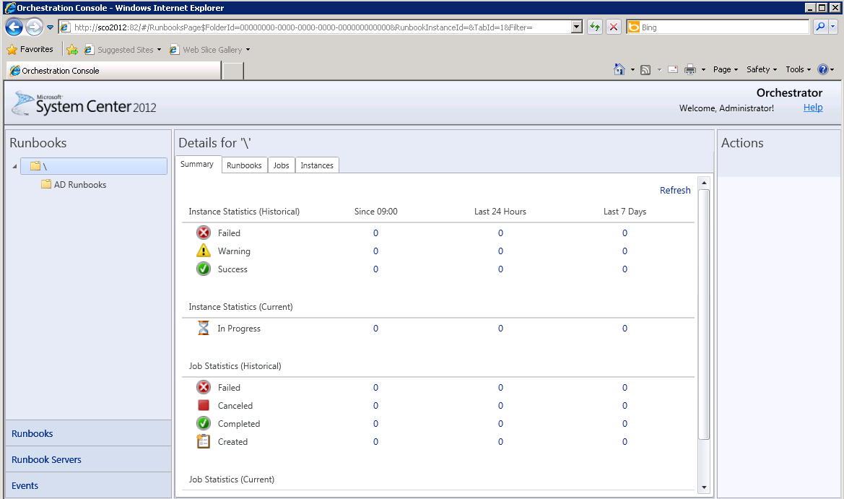
Orchestrator Tools
Orchestration console
Runbooks can be started or stopped
Real-time status on a web browser can be viewed
Orchestrator web service
REST-based service that enables custom applications to connect to Orchestrator
Console uses this web service to interact with Orchestrator
Notes:
So we’ve talked a little bit already about the tools, which tools are available, the Orchestration console actually is where you can control the runbooks, you can start to stop them, you see some real-time status and that’s all part of a web browser application.
Then we have the Orchestrator web service that’s the REST – based service that really enables custom applications and third party applications to connect to Orchestrator and work with Orchestrator runbooks as well as the Orchestration console that also uses the same REST-based web service.

Slide 19
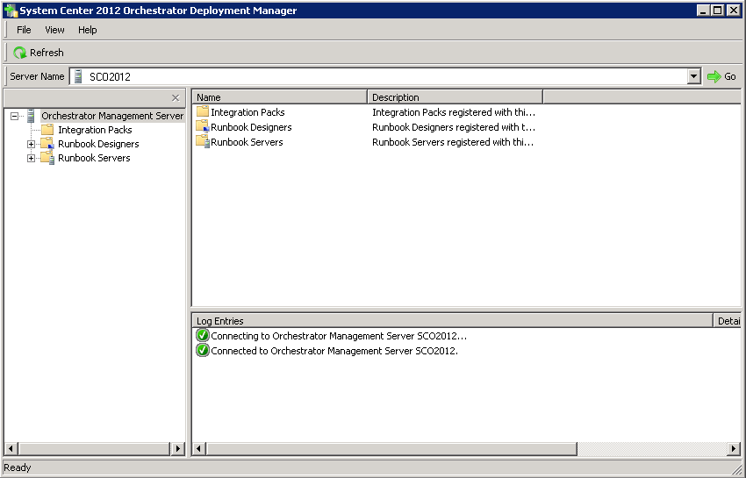
Orchestrator Tools (cont.)
Deployment Manager
Tool used to deploy SCO components (e.g. Runbook Servers, Designer) and Integration Packs
Runbook Tester
Run-time tool used to test runbooks developed in the Runbook Designer
Notes:
Then we have a couple of other tools deplyment manager, that tool actually helps you to deploy Orchestrator components like if you want to deploy a new runbook server or you want to deploy a new designer or you want to install a new integration pack no matter if it’s from Microsoft or a third party vendor you’re using the deployment manager to import that and deploy those components to your orchestration environment.
The runbook tester it’s actually a runtime tool that you can use to test runbooks so if you’re familiar with testing in Visual Studio for example it gives you a very same experience where you’re able to really depack (?) your runbooks step by step and activity by activity to see what’s going on in your runbook.

Slide 20
Connectivity
Source | Targeted Computer | Default Port | Configurable | Notes
Runbook Designer | Management server | 125, 1024-65535 | Yes | Runbook Designer communicates with management server over DCOM (default port 135) and dynamically allocates a port between 1024 and 65535.
Management server runbook server Web service | orchestration database | 1433 | Yes | Specified during the Microsoft SQL Server 2008 installation
Client browser | Orchestrator REST-based web service | 81 | Yes | Specified during Orchestrator installation. Both ports must be accessible for the Orchestration console.
 | Orchestration console | 82
Notes:
So from a connectivity perspective I don’t want to go into much detail here that’s just for reference here that you’re able to look at that if you’re going to set your orchestrator architecture in your datacenter, there are different ports that must be enabled to make the communication happen between the different components within Orchestrator.

Slide 21
Service Accounts and Permissions
Management Server Account
Maintaining database, communicating with designers and deployment manager
Permission to log on to the Management Server as a Service
Member of Admin role in Orchestration database
Can be a local account or domain account
Does not have to be Administrator/Domain Admin account
Runbook Server Account
Runs Runbook Server and communicate with database
Recommended to be an domain account
By default all activities run under this account, but can be configured differently on specific activities
Permission to log on to the runbook server as a service
Might require additional permissions depending on activities
Notes:
Talk a little bit about service accounts and permission, there are two important accounts here, first of all it’s the Management Server Account, that’s important for maintaining database for communicating with the designers and the deployment manager and it must be part of the admin role orchestration database.
One more important account user service account is the Runbook Server Account actually that’s the one that will be used by default by all activities that will use that runbook server account. You can configure that differently by defining that on the activities but by default this runbook server account is used by all activities. And it’s recommended to be a domain account so that you’re able to span your workflows across machines and environments.

Slide 22
Redundancy
Datastore (SQL)
Central to SCO functionality
High availability configuration (clustering) recommended
Runbook Server
Deploy multiple Runbook Servers to provide redundancy
Failover is automatic when multiple Runbook Servers are present
Runbooks
Perform exports periodically as a backup method
Error handling and redundancy can be added at the object level within runbooks
Other Components
Designer, License Manager, Deployment Manager and Operator Console are design time components and do not require redundancy
Notes:
A short slide about redundancy, from a datastore perspective you’re using a server which is central to the orchestrator functionality so that’s one of the most important parts of your orchestrator environment so we have all the high availability configuration available and it’s really recommended to use clustering for your datastore for example.
Runbook servers it’s possible to deploy multiple runbook servers not only to increase capacity but also to provide redundancy in your environment and actually the failover if there is runbook failure that will happen automatically as soon as you have more than one runbook server available.
The runbooks, you better perform exports periodically as back up and you should also include error handling and redundancy on an object level within the runbooks.
And all the other components like the Designer, Deployment Manager, License Manager and the Operator Console are design time components and do not fully require redundancy at that point and time.

Slide 23
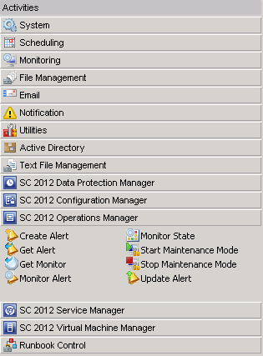
Orchestrator Extensions
Integration pack (IP)
Collection of custom activities specific to a product or technology
Microsoft and other companies provide IPs to interact with their products within a runbook
Orchestrator Integration Toolkit
Extend the library of activities
Wizard-based tools to create new activities and IPs
Developers can use it to create IPs from custom activities that they build using the Orchestrator SDK.
Notes:
So I’ve mentioned Integration packs a couple of times already so it’s time to have a look at that as well so that’s part of the way to extend Orchestrator. So an integration pack is a set of custom activities specific to a product or a technology. So Microsoft provides a couple of integration packs for example for System Center 2012 components but also for others and other companies providing integration packs as well to make it possible to interact with their products within a runbook.
And on the right side the screen shot you see here, that’s actually the activity pane within Orchestrator, you see a couple of activities that are there out of the box like system, scheduling, monitoring, file management and so on, but you also see a couple of integration packs that were imported after installation of Orchestrator; like the SC 2012 Operations Manager integration pack and below you see a couple of activities that are part of that integration pack for Operations Manager. So integration packs really one way to extend Orchestrator.
Another way is using the Orchestrator Integration Toolkit which extend the library of activities it’s actually a wizard based tool to create new activities to use and bundle those activities to integration packs and developers are also able to use the Orchestrator SDK to create integration packs to build some custom activities as well and they will show up the same way as integration pack will do in that screen shot.

Slide 24
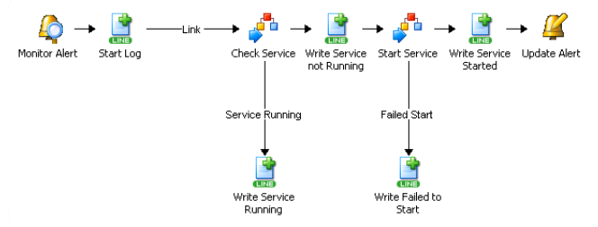
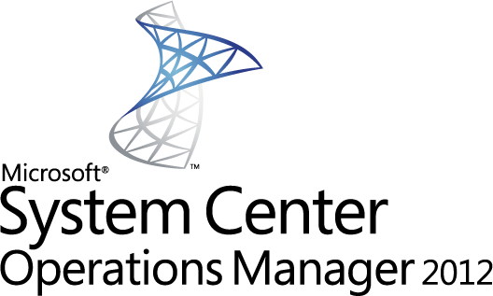
SC 2012 Operations Manager IP
Create Alert
Get Alert
Monitor Alert
Get Monitor
Monitor State
Start Maintenance Mode
Stop Maintenance Mode
Update Alert
Notes:
So now I would like to try through those System Center 2012 Integration packs so for the Operations Manager you see you have a couple of alert specific activities for example you’re able to really easily create alerts, to get alerts to monitor for specific alert, you’re able to start the maintenance mode for example or stop the maintenance mode or you’re also able to update an alert for example so those are parts of the System Center Operations Manager 2012 Integration Pack.

Slide 25
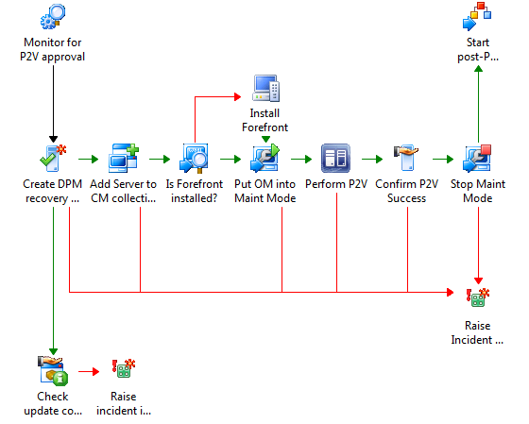
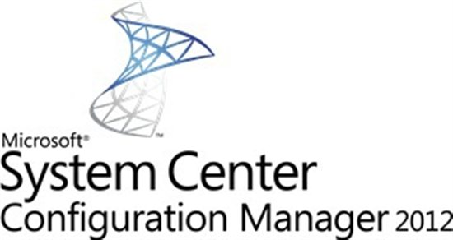
SC 2012 Configuration Manager IP
Add Collection Rule
Create Collection
Delete Collection
Create Collection Rule
Deploy App/Program/Update/Task Sequence
Update Collection Member
Get Collection Member
Get Deployment Status
Perform Client Action
Notes:
For Configuration Manager you have a couple of collection specific rules for example to create, delete a collection, you're able to add members to a specific collection, you’re able to deploy applications, you’re able to deploy updates on task sequence and you can also perform some client action within the Configuration Manager IP.

Slide 26
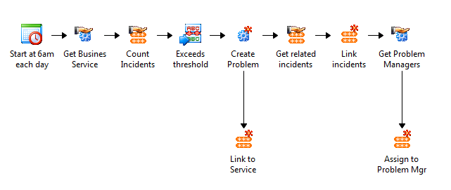
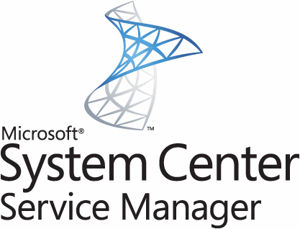
SC 2012 Service Manager IP
Create Change With Template
Create Object
Create Incident With Template
Create Related Object
Create Relationship
Delete Relationship
Get Activity
Get Object
Get Relationship
Monitor Object
Update Activity
Update Attachment
Update Object
Notes:
For Service Manager you have also a whole bunch of activities for example to create objects, to create incidents, to create changes using templates that you have defined in service manager then you can create relationship between those objects or delete them, you have a couple of get activities like get object, get relationship, and you’re also able to update objects and specifically activity and attachment there are specific activities for that as well.

Slide 27
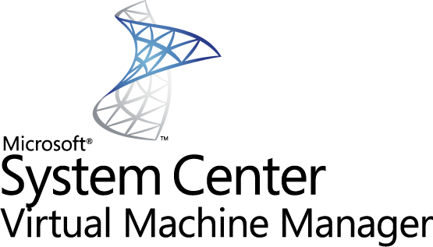
SC2012 Virtual Machine Manager IP
Create Checkpoint
Create New Disk
Create Disk From VHD
Create Network Adapter
Create User Role
Create VM from Template
Create VM from VHD
Create VM from VM
Get Checkpoint
Get Disk
Get Network Adapter
Get User Role/Get User Role Quota
Get VM
Manage Checkpoint
Move VM
Remove User Role
Remove VM
Repair VM
Resume VM
Run VMM PS Script
Shut Down VM
Start VM
Stop VM
Pause VM
Update Network Adapter
Update Disk
Update VM
Notes:
So for Virtual Machine Manager you’re able to create a whole bunch of stuff like creating new disks, creating new user roles, creating virtual machines, both from template, from VHD or from VM, you have a couple of get activities but you’re also able to really control your virtual machines; shut down virtual machines, to start, to stop, to pause them and you’re also able to update stuff like network adapters, disks and virtual machines.

Slide 28
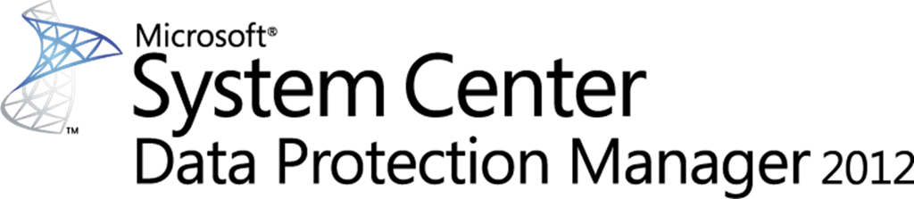
SC 2012 Data Protection Manager IP
Create Recovery Point
Get Data Source
Get Recovery Point
Get DPM Server Capacity
Protect Data Source
Recover SharePoint
Recover SQL
Recover VM
Run DPM PS Script
Notes:
For Data Protection Manager you’re able to create recovery points, you’re able to protect data sources and you’re also able to recover different workloads like SharePoint, SQL and virtual machines.

Slide 29
Microsoft Integration Packs
Active Directory IP
HP iLO and OA IP
HP Operations Manager IP
IBM Tivoli Netcool/OMNIbus IP
VMware vSphere IP
System Center IPs
Configuration Manager
Data Protection Manager
Operations Manager
Service Manager
Virtual Machine Manager
http://technet.microsoft.com/en-us/library/hh295851.aspx
41 built-in workflow standard activities
Notes:
So couple of more integration packs besides the System Center 2012 components there’s an Active Directory Integration Pack, there are some HP integration packs available for their Operations Manager, for IBM Tivoli, and also for VMware vSphere there’s also an integration pack that Microsoft provides and that’s actually on the right side you see the link where you’re able to download those integration packs to import them into your environment.

Slide 30
Other Integration Packs
BladeLogic Operations Manager
BMC Atrium CMDB
BMC Event Manager
BMC PATROL
BMC Remedy ARS
CA AutoSys
CA eHealth
CA NSM
CA Service Desk
CA Spectrum
EMC Smarts InCharge
HP Asset Manager
HP iLO
HP OpenView Operations
HP OpenView Service Desk
HP Network Node Manager
HP Service Manager
IBM Tivoli NetCool / OMNIbus
IBM Tivoli Enterprise Console
IBM Tivoli Storage Manager
Symantec Net Backup
VMware vSphere
http://technet.microsoft.com/en-us/library/hh295851.aspx
Notes:
And there is a whole bunch of other integration packs available from third party vendors like BMC, CA, HP, IBM, Symantec, VMware, HP, I mentioned that already, EMC, and that’s also the URL to download those integration packs to use them in your environment.

Slide 31
Summary
SCO Architecture
Review of Use Case Scenarios
Inside SCO
SCO Components and Services
Understanding Component Connectivity Requirements
Understanding Component Security
Discuss redundancy in SCO Architecture
Review Integration Packs
Notes:
So with that we are almost at the end of that first session about Orchestrator, I would like to give you a short summary of what we’ve covered in that first session. First of all we had a look on the architecture of Orchestrator of all the components that are part of that, we did a review of the use cases, we had a look on every component and service within Orchestrator, I gave you a quick view on the component connectivity requirements and also about the security as well as we discussed redundancy in the Orchestrator architecture and of course we did a review of integration packs and how you’re able to extend Orchestrator with those integration packs.

Slide 32
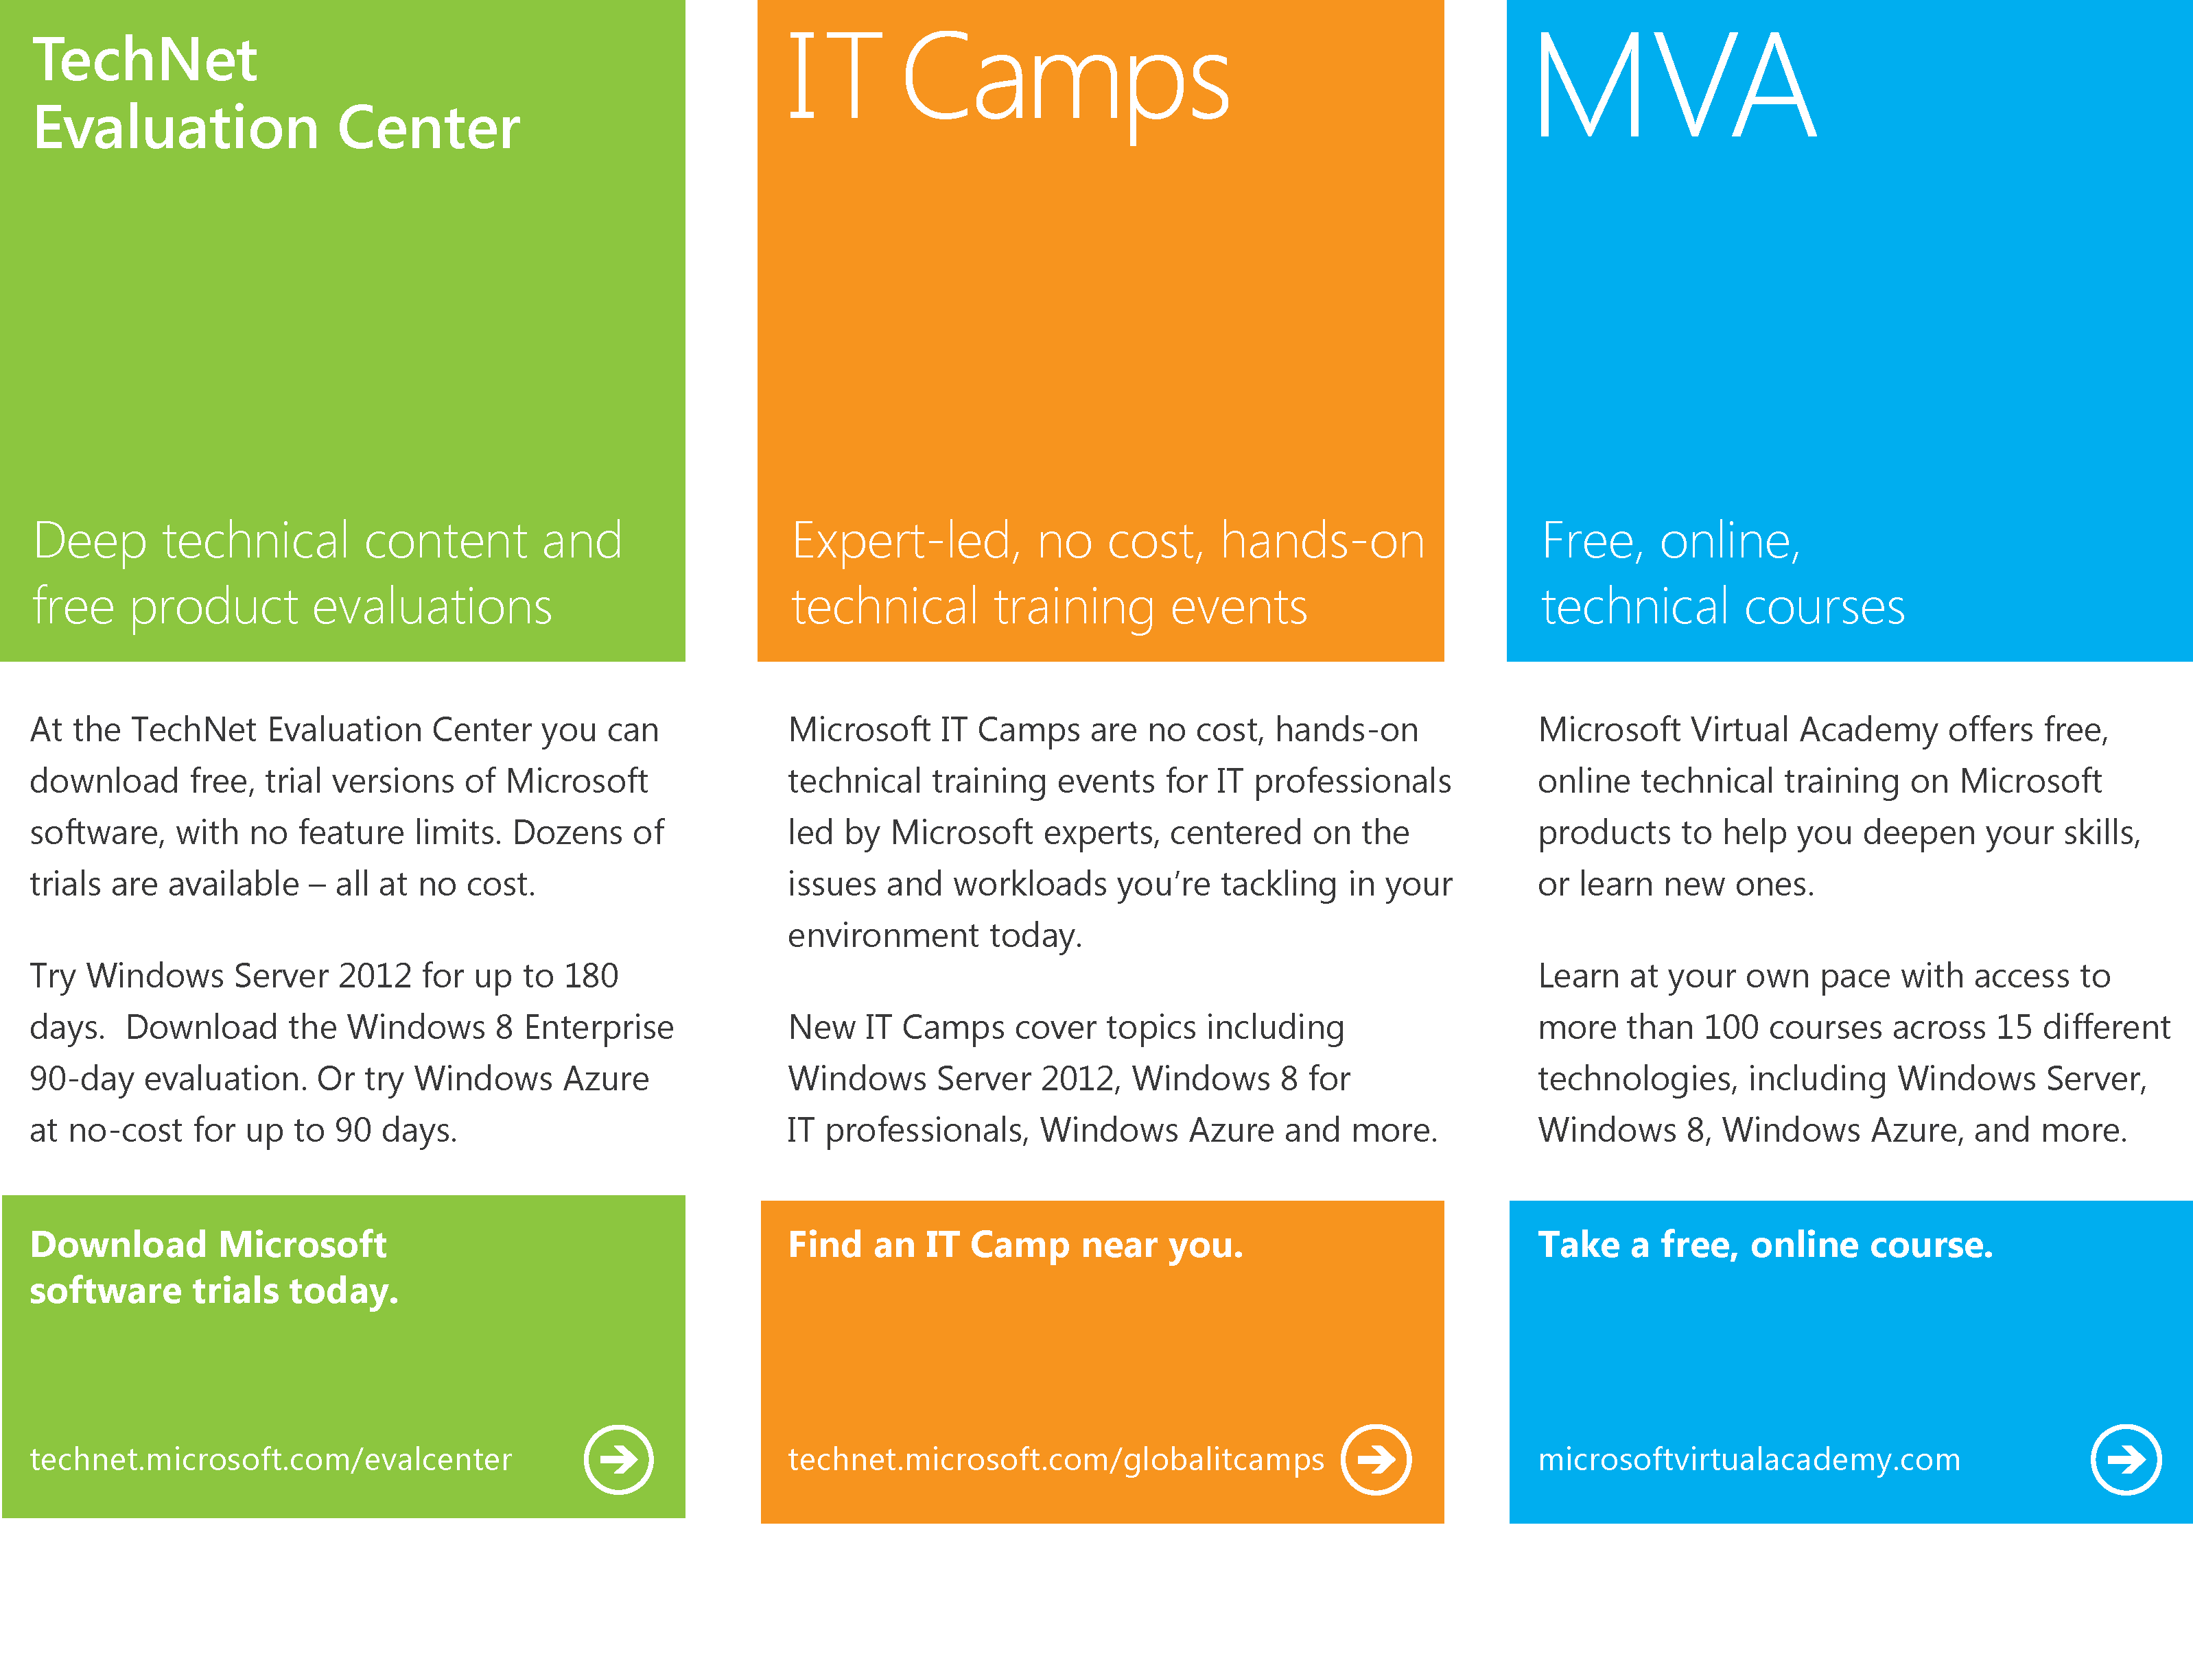
Notes:
So with that I would like to close the first session but I would like also to give you a quick side step to all the different material that is available, first of all on Tech Net Eval Center you’re able to download free trial versions of Microsoft software, there are no feature limits and it’s all at no cost so go there at Technet.microsoft.com/evalcenter.
IT camps, it’s actually also at no cost, hands on technical training events for IT pros you will find that on technet.microsoft.com/gloablitcamps.
And last but not least it’s the Microsoft Virtual Academy that offers free online technical trainings and you will find that on microsoftvirtualacademy.com.

Slide 33

© 2012 Microsoft Corporation. All rights reserved. Microsoft, Windows, Windows Vista and other product names are or may be registered trademarks and/or trademarks in the U.S. and/or other countries.
The information herein is for informational purposes only and represents the current view of Microsoft Corporation as of the date of this presentation. Because Microsoft must respond to changing market conditions, it should not be interpreted to be a commitment on the part of Microsoft, and Microsoft cannot guarantee the accuracy of any information provided after the date of this presentation. MICROSOFT MAKES NO WARRANTIES, EXPRESS, IMPLIED OR STATUTORY, AS TO THE INFORMATION IN THIS PRESENTATION.
Notes:
So that’s it for this session, thanks for joining us today and hope to see you soon.

